Slide 1
Fish and Wildlife Management Merit Badge
Troop 344 and 9344
Pemberville, OH

Slide 2
Fish and Wildlife Management Merit Badge Requirements
Describe the meaning and purposes of fish and wildlife conservation and management.
List and discuss at least three major problems that continue to threaten your state's fish and wildlife resources.
Describe some ways in which everyone can help with fish and wildlife conservation.
List and describe five major fish and wildlife management practices used by managers in your state.

Slide 3
Fish and Wildlife Management Merit Badge Requirements
Do ONE of the following:
Construct, erect, and check regularly at least two artificial nest boxes (wood duck, bluebird, squirrel, etc.) and keep written records for one nesting season.
Construct, erect, and check regularly bird feeders and keep written records of the kinds of birds visiting the feeders.
Develop and implement a fishery improvement project or a backyard wildlife habitat improvement project. Share the results with your counselor.
Design and construct a wildlife blind near a game trail, water hole, salt lick, bird feeder, or birdbath and take good photographs or make sketches from the blind of any combination of 10 wild birds, mammals, reptiles, or amphibians.

Slide 4
Fish and Wildlife Management Merit Badge Requirements
Do ONE of the following:
Observe and record 25 species of wildlife. Your list may include mammals, birds, reptiles, amphibians, and fish. Write down when and where each animal was seen.
List the wildlife species in your state that are classified as endangered, threatened, exotic, non-native, game species, furbearers, or migratory game birds. Discuss with your counselor management practices in place or being developed for at least three of these species.
Start a scrapbook of North American fish and wildlife. Insert markers to divide the book into separate parts for mammals, birds, reptiles, amphibians, and fish. Collect articles on such subjects as life histories, habitat, behavior, and feeding habits on all of the five categories and place them in your notebook accordingly. Articles and pictures may be taken from newspapers or science, nature, and outdoor magazines, or from other sources including the internet (with your parent's permission). Enter at least five articles on mammals, five on birds, five on reptiles, five on amphibians, and five on fish. Put each animal on a separate sheet in alphabetical order. Include pictures whenever possible.

Slide 5
Fish and Wildlife Management Merit Badge Requirements
Do ONE of the following:
Determine the age of five species of fish from scale samples or identify various age classes of one species in a lake and report the results.
Conduct a creel census on a small lake to estimate catch per unit effort.
Examine the stomach contents of three species of fish and record the findings. It is not necessary to catch any fish for this option. You must (may) visit a cleaning station set up for fishermen or find another, similar alternative.
Make a freshwater aquarium. Include at least four species of native plants and four species of animal life, such as whirligig beetles, freshwater shrimp, tadpoles, water snails, and golden shiners. After 60 days or observation, discuss with your counselor the life cycles, food chains, and management needs you have recognized. After completing requirement 7d to your counselor's satisfaction, with your counselor's assistance, check local laws to determine what you should do with the specimens you have collected.
Using resources found at the library and in periodicals, books, and the internet (with your parent's permission), learn about three different positions held by fisheries and/or wildlife professionals. Find out the education and training requirements for each position.

Slide 6
Requirement 1
Describe the meaning and purposes of fish and wildlife conservation and management.

Slide 7
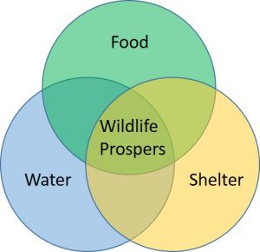
Meaning
Wildlife management is the science and art of managing the wildlife—both animals and fish—with which we share our planet.
Maintaining the proper balance and the dynamics that go with it requires humankind’s attention.
This includes managing and maintaining wildlife habitats of all kinds.
We use this stewardship tool to help minimize or eradicate the possibility of extinction of any given species.

Slide 8
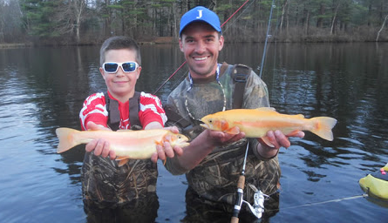
Purpose
The purpose of fish and wildlife management is to encourage healthy fish and wildlife populations and their associated habitats while preventing lost populations and additional extinction of plants and animals.
To accomplish this goal, a manager must first understand and address individual species habitat requirements.
Healthy populations are part of healthy communities and key to the success of one often relies on productive and viable habitats.
A second purpose is to have sustainable fish and wildlife populations that can provide for human appreciation, recreation, and harvest for millions of Americans.
The economic benefit of the above interests represents billions of dollars annually and many thousands of jobs for those who engage or support these activities.

Slide 9
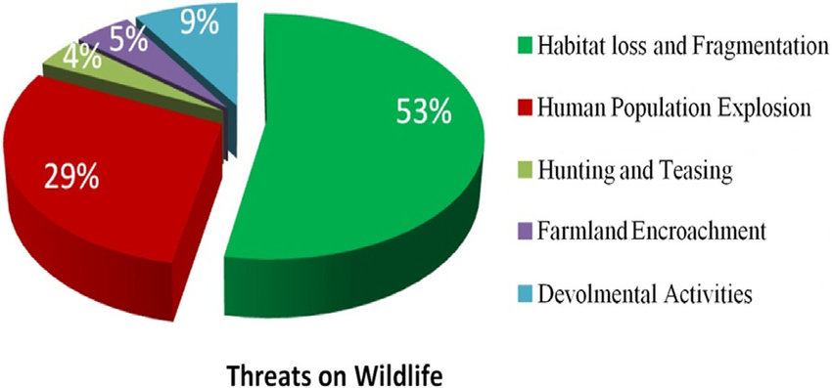
Requirement 2
List and discuss at least three major problems that continue to threaten your state's fish and wildlife resources.

Slide 10
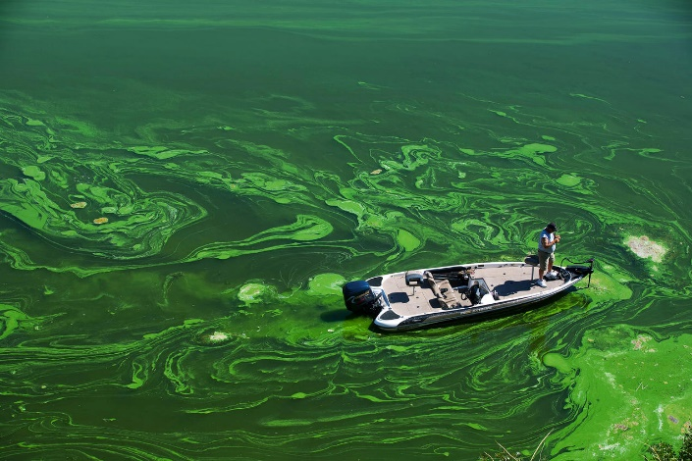
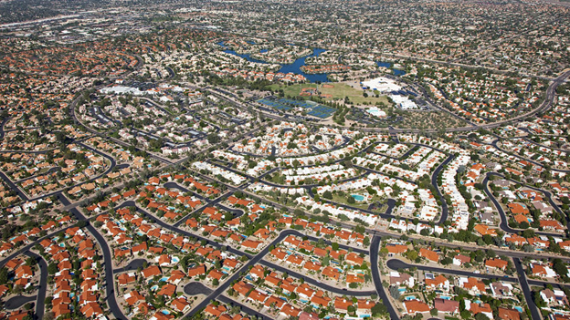
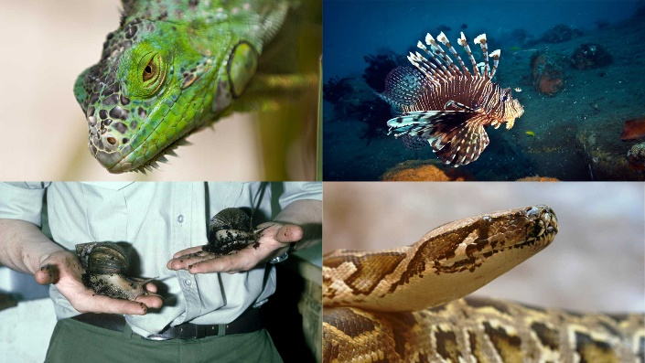
Threats to Fish and Wildlife
The most common problems shared by most states are:
Pollution
Overharvest of some species
Overpopulation of some species
Habitat fractionation
Habitat degradation or loss due to development and encroachment by humans
Wildlife disease
The introduction of exotic or invasive species
Fish and wildlife managers often can only address certain major issues because many states are experiencing severe funding constraints.

Slide 11
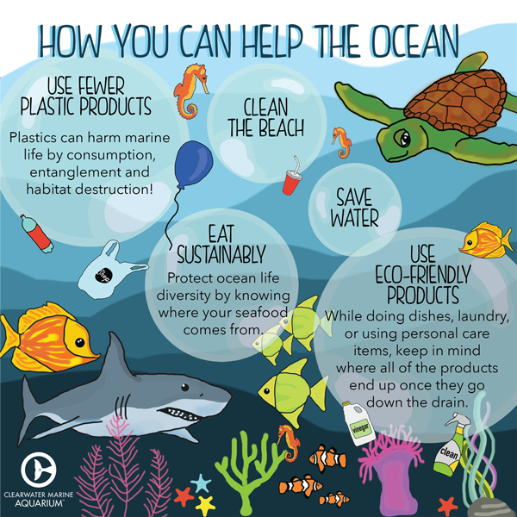
Requirement 3
Describe some ways in which everyone can help with fish and wildlife conservation.

Slide 12
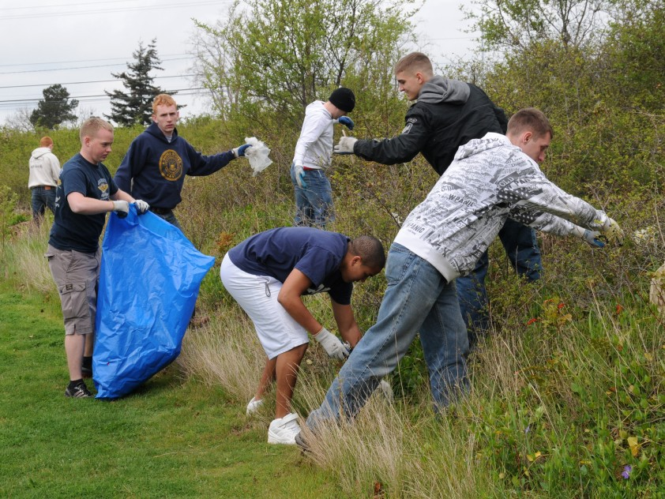
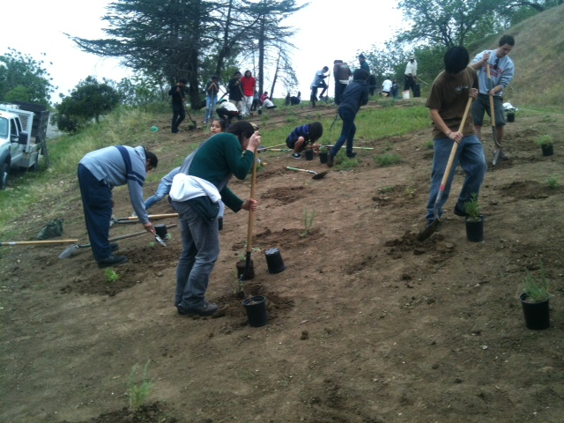
What You Can Do
The things we do in our daily lives can help improve our lands so they provide a better place for wildlife and humans to live.
Volunteer at a wildlife refuge
Organize litter cleanups and recycling drives
Support natural areas and nature centers.
Participate in habitat restoration projects.
Walk, ride your bike, carpool, or use public transportation. Using less fuel reduces the need to extract energy resources and prevents changing habitat that is home to fish, wildlife, and plants.
If you observe evidence of wildlife poaching, contact your state fish and game office
Follow fishing and hunting laws.

Slide 13
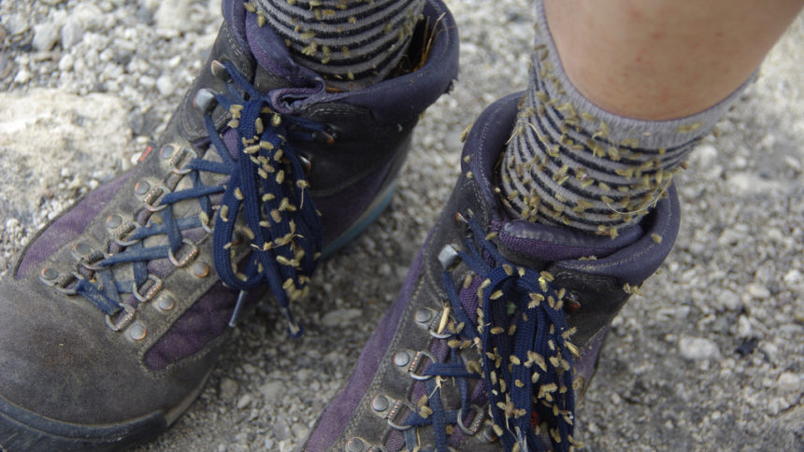
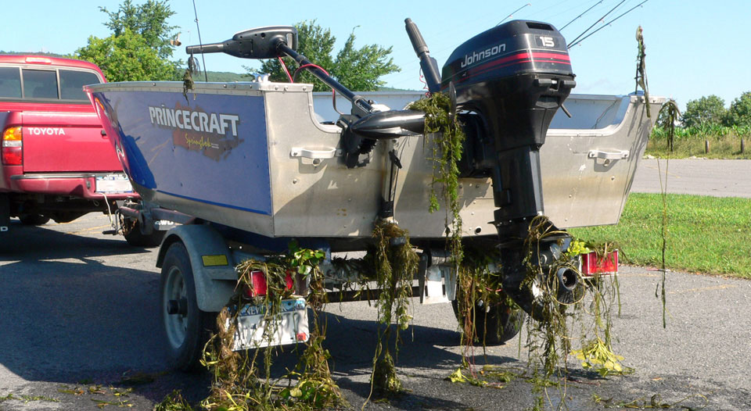
What You Can Do
Curb the effects of invasive species. People and human activity are the major transporters of invasive species.
After a hike, shake out your socks and remove any weeds and seeds from your shoes before heading home.
When you are through boating, inspect your equipment and boat before leaving the site. You don’t want to transport any plants, water, mud, leftover bait, or fish and other living things to another area.
If you have caught any fish, release it back only to the area where it was caught. Never transport your catch and release it somewhere else. In addition, never release anything from your home aquarium to a lake, pond, or other body of water.
If you are riding a bike, motorcycle, horse, or any other transportation across long distances, be sure you don’t pick up any “hitchhikers” along the way, such as seeds, plant parts, and bugs.

Slide 14
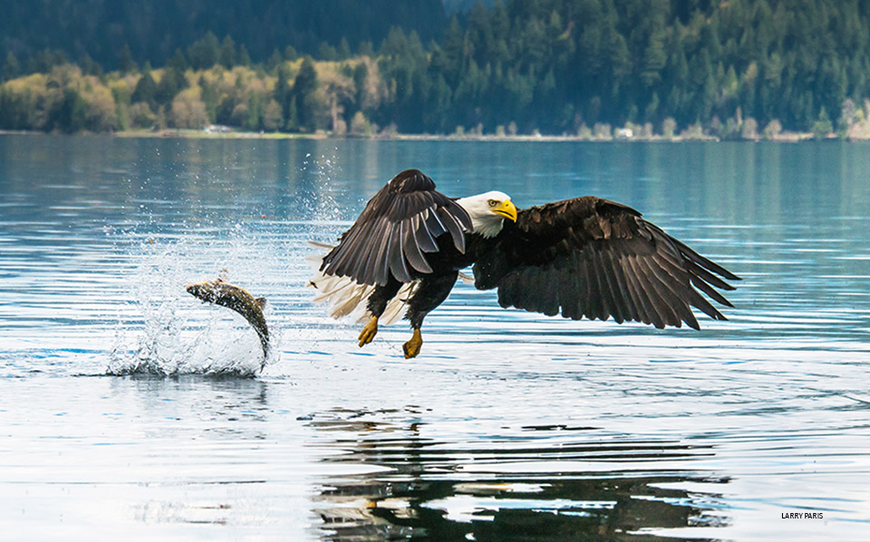
Requirement 4
List and describe five major fish and wildlife management practices used by managers in your state.

Slide 15
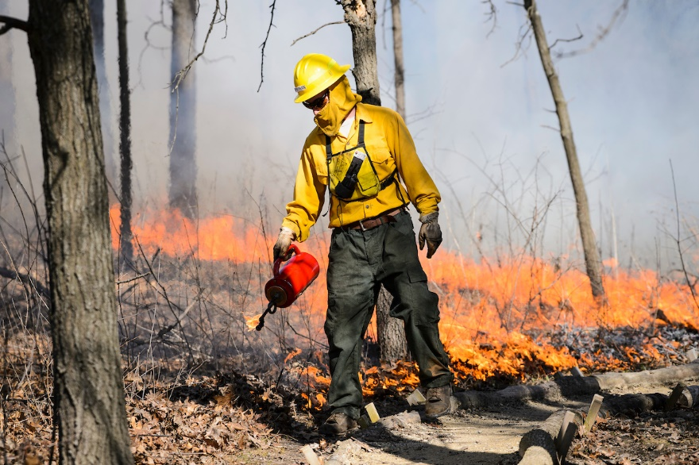
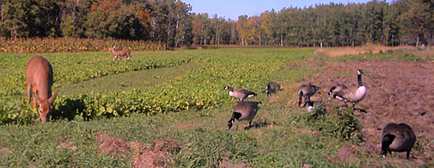
Fish and Wildlife Management Practices
Wildlife management consists of projects that affect wildlife populations and wildlife recreational users.
These projects usually involve habitat manipulation, management of wildlife populations, land acquisition, research, or the creation of opportunities for people to enjoy wildlife.
Examples of management practices:
Fires and selective burning - Controlled fires provide new growth in forests and open lands.
Food plots - Food plots create winter feeding areas for wildlife. These plots are small areas planted with a mixture of grasses and clovers in open areas in the woods and on old logging roads.

Slide 16
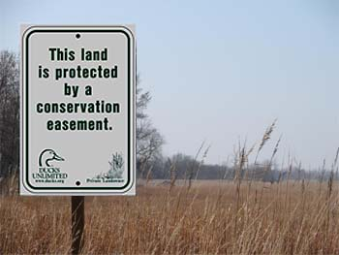
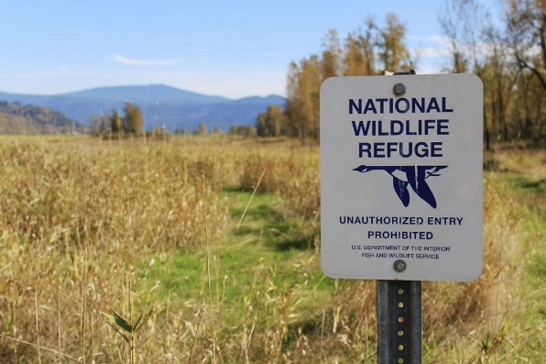
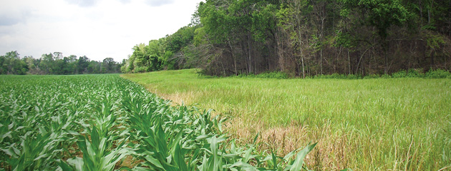
Fish and Wildlife Management Practices
Examples of management practices (continued):
Conservation easements - Private landowners sign contracts that agree their land will not be developed, creating conservation easements that maintain habitats for wildlife.
Wildlife refuges and management areas - Government agencies and private landowners purchase land to preserve its natural beauty and the wildlife present in these areas.
Edge control - Edge control creates habitat for upland birds, small game and some big game species. Instead of cultivating right up to the edge of the woods, farmers leave a swath of land around the field to create shelter and food for the wildlife. This area is cut every two to three years.

Slide 17
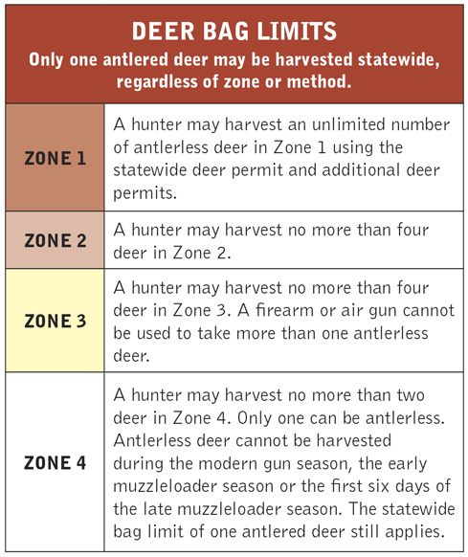
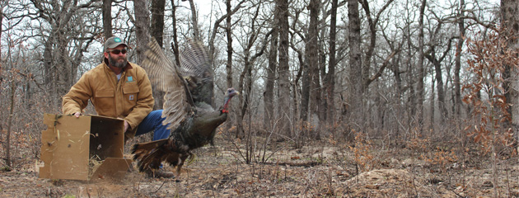
Fish and Wildlife Management Practices
Examples of management practices (continued):
Hunting - Hunting helps maintains the correct number of specific species for a given amount of habitat or area; hunting also provides wildlife biologists with valuable information on species and population numbers in a given area. Using this information, hunting regulations and daily bag limits are determined each year for the season’s duration. Bag limits are the maximum number of game animals a hunter may harvest in a given day or hunting season.
Trapping - Trapping reduces the quantity of certain wildlife types in a given area. It is used for relocating specific game to areas that have known depleted populations.

Slide 18
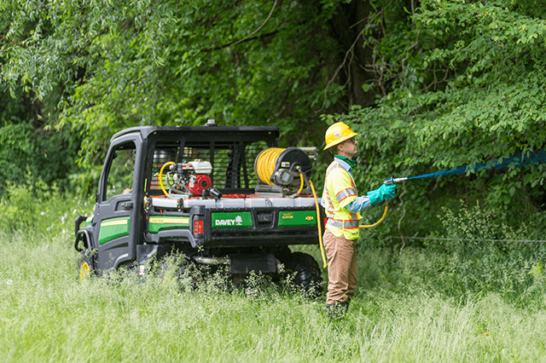
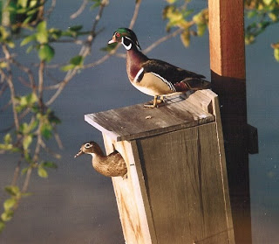
Fish and Wildlife Management Practices
Examples of management practices (continued):
Control Nonnative Invasive Species – Invasive species have been detrimental to native communities because many nonnatives outcompete native species. Thus, populations of certain wildlife species have declined as a result of nonnative invasive species. Control practices include the use of chemicals and harvesting (physically removing) nonnative species.
Artificial Nesting Structures - Many wildlife species nest in cavities. Natural cavities are too few and of too poor quality to provide good nesting opportunities. Artificial nesting structures benefit wildlife and provide much enjoyment to the builders.

Slide 19
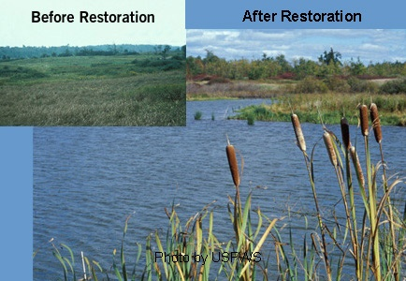
Fish and Wildlife Management Practices
Examples of management practices (continued):
Wetland Habitat Management for Wildlife - Wetlands in the United States were considered wastelands that needed to be filled or drained to be made usable and profitable. Wetlands are now viewed as valuable real estate that needs to be protected and restored. Wetlands are particularly important to wildlife. Nearly 32% of Ohio’s endangered and threatened wild species live in wetland habitat. Over one-third of Ohio’s wildlife depend upon wetlands for its survival.

Slide 20
Requirement 5
Do ONE of the following:
Construct, erect, and check regularly at least two artificial nest boxes (wood duck, bluebird, squirrel, etc.) and keep written records for one nesting season.
Construct, erect, and check regularly bird feeders and keep written records of the kinds of birds visiting the feeders.
Develop and implement a fishery improvement project or a backyard wildlife habitat improvement project. Share the results with your counselor.
Design and construct a wildlife blind near a game trail, water hole, salt lick, bird feeder, or birdbath and take good photographs or make sketches from the blind of any combination of 10 wild birds, mammals, reptiles, or amphibians.

Slide 21
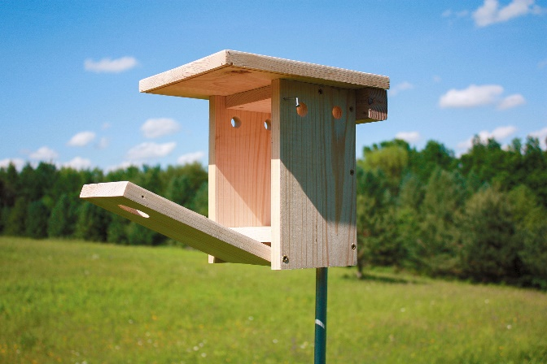
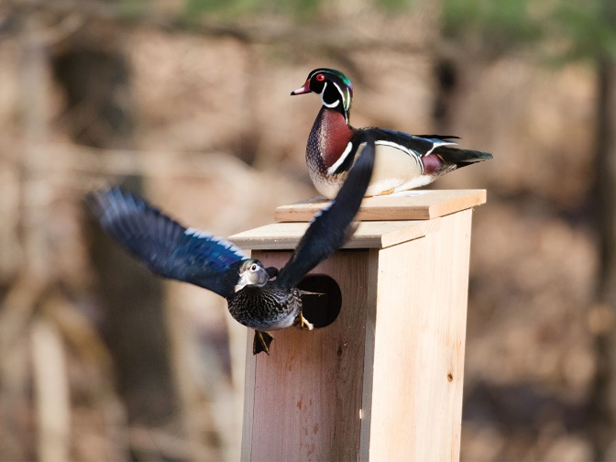
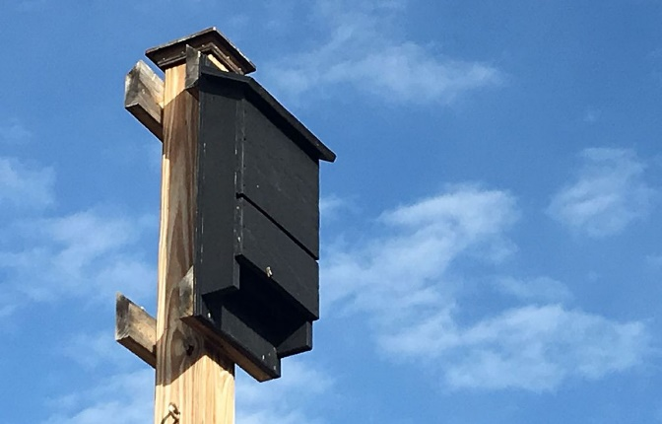
Requirement 5a
Download Bluebird House Plans and Instructions.
or
Download Build a Duck Nest Box.
or
Download Bat Box Plans.

Slide 22
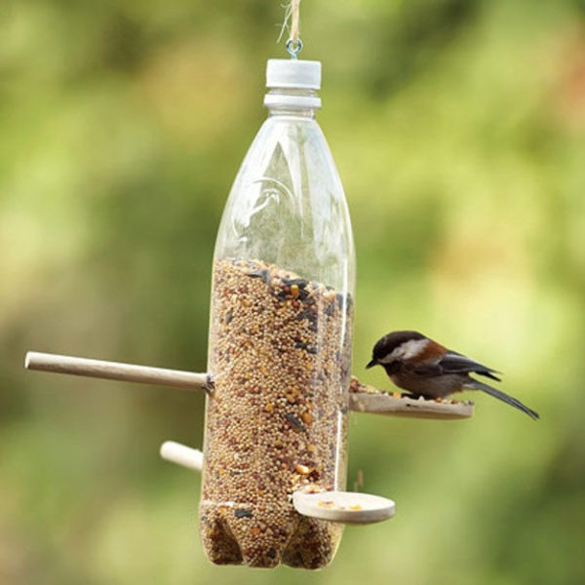
Requirement 5b
Download How to Build a Bird Feeder with Recycled Materials

Slide 23
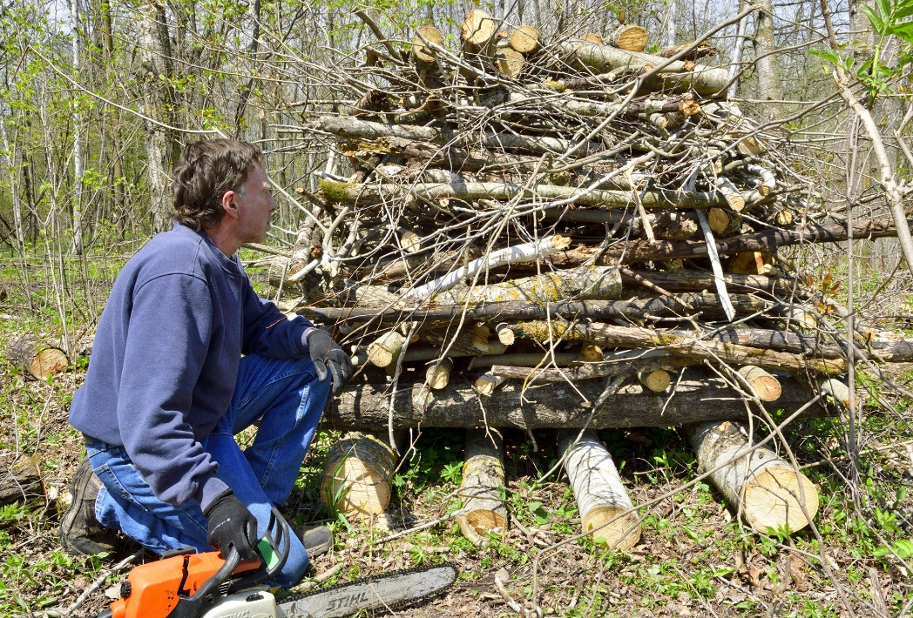
Requirement 5c
Download Brush Piles for Wildlife

Slide 24
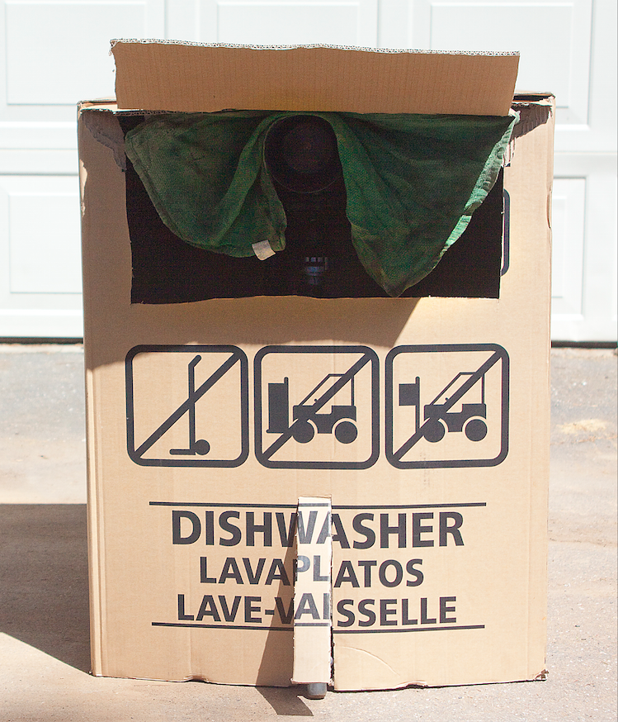
Requirement 5d
Download Wildlife Viewing Blind Instructions

Slide 25
Requirement 6
Do ONE of the following:
Observe and record 25 species of wildlife. Your list may include mammals, birds, reptiles, amphibians, and fish. Write down when and where each animal was seen.
List the wildlife species in your state that are classified as endangered, threatened, exotic, non-native, game species, furbearers, or migratory game birds. Discuss with your counselor management practices in place or being developed for at least three of these species.
Start a scrapbook of North American fish and wildlife. Insert markers to divide the book into separate parts for mammals, birds, reptiles, amphibians, and fish. Collect articles on such subjects as life histories, habitat, behavior, and feeding habits on all of the five categories and place them in your notebook accordingly. Articles and pictures may be taken from newspapers or science, nature, and outdoor magazines, or from other sources including the internet (with your parent's permission). Enter at least five articles on mammals, five on birds, five on reptiles, five on amphibians, and five on fish. Put each animal on a separate sheet in alphabetical order. Include pictures whenever possible.

Slide 26
Requirement 6a
Species | When Seen | Where Seen

Slide 27
Requirement 6b
Wildlife Species | Endangered | Threatened | Exotic | Non-native | Game Species | Furbearer | Migratory Game Bird

Slide 28
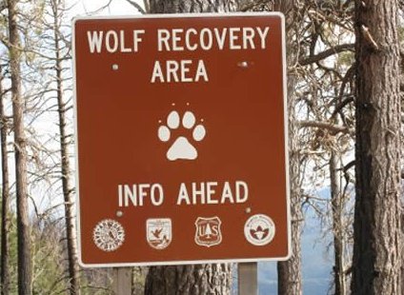
Management Practices for Endangered Species
The process of developing a recovery plan is unique for each species. Factors considered include:
the types of factors that threaten the species
the magnitude of those threats
the degree to which the threats can reversed
the biology of the species
the current number of individuals of the species and their distributions
Recovery plans that have been developed since 1978 are available online by clicking on the Endangered Species Recovery Plans link.

Slide 29
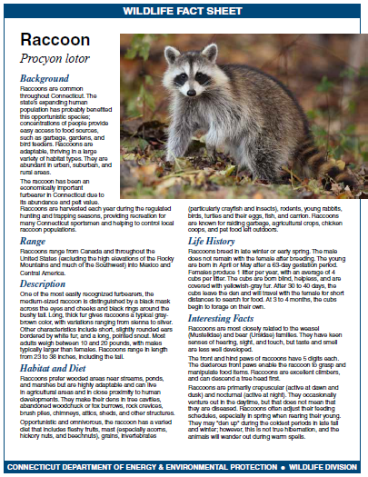
Requirement 6c
Click on the following link to download Wildlife Fact Sheets

Slide 30
Requirement 7
Do ONE of the following:
Determine the age of five species of fish from scale samples or identify various age classes of one species in a lake and report the results.
Conduct a creel census on a small lake to estimate catch per unit effort.
Examine the stomach contents of three species of fish and record the findings. It is not necessary to catch any fish for this option. You may visit a cleaning station set up for fishermen or find another, similar alternative.
Make a freshwater aquarium. Include at least four species of native plants and four species of animal life, such as whirligig beetles, freshwater shrimp, tadpoles, water snails, and golden shiners. After 60 days or observation, discuss with your counselor the life cycles, food chains, and management needs you have recognized. After completing requirement 7d to your counselor's satisfaction, with your counselor's assistance, check local laws to determine what you should do with the specimens you have collected.

Slide 31
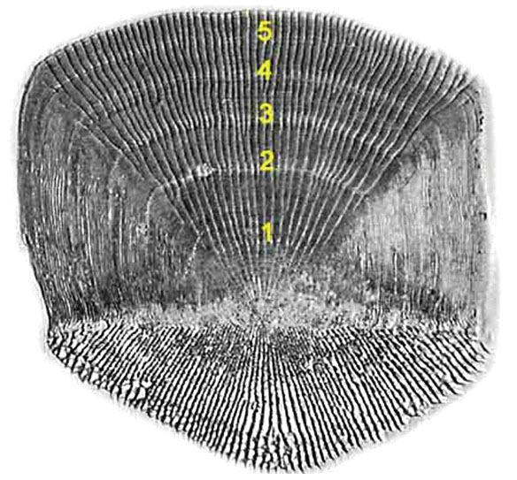
7a Determine the Age of Fish from Scales
Similar to tree rings, scales show rings that indicate the age of a fish.
Rings that are farther apart form during the summer when food is abundant and the fish is growing quickly.
Closely spaced rings form in winter when the fish grows slowly.
These patterns are recorded on each individual scale (there are several rings per scale.)
The core (region near the base of the scale where the rings originate) formed when the fish was a fry.
Those near the edge are the most recent.

Slide 32
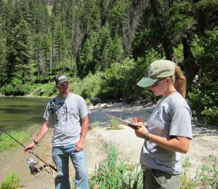
7b Conduct a Creel Census
A simple survey will help compile the data for a Creel Census.
As anglers return to the dock after a day of fishing, poll them about their catch.
How many hours were they out, and how many fish did they catch?
The more anglers you poll, the more accurate your results will be.
Total # of fish caught/total # of hours of fishing= # of fish caught per hour of fishing
# of fish caught per hour of fishing/total # of anglers = number of fish the average angler catches in an hour at one body of water.
The results of a creel census are helpful in estimating the number of fish the average angler catches in an hour at one body of water.

Slide 33
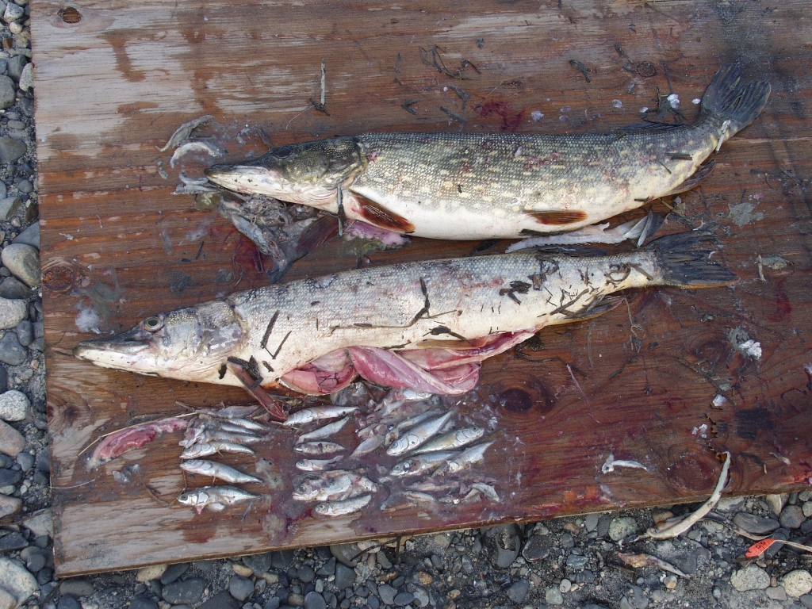
7c Examining the Stomach Contents of Fish
Examining the stomach contents of fish will tell you what that species feeds on in the wild—insects, worms, smaller fish, vegetation, and so on.
It will give you a good idea of the best bait or lure to use.
Resource managers use this same information to help ensure that the species has access to the most appropriate food sources.

Slide 34
7c Examining the Stomach Contents of Fish
If you are not able to visit a cleaning station or find a similar alternative, you may need to gut a fish yourself.
After skinning or scaling the fish, follow these steps.
Starting at the anal opening near the tail, cut through the skin from the belly to the gills. Be careful not to cut too deeply and destroy the organs.
Open the belly and use your fingers to carefully remove the gills from the fish. Scrape out the kidney line (it’s reddish brown) along the backbone. Detach the entrails from the fish by cutting them away from the fish’s body; be careful not to burst the stomach.
Carefully slice open the stomach and remove the contents. If possible, identify what the fish has been eating.

Slide 35
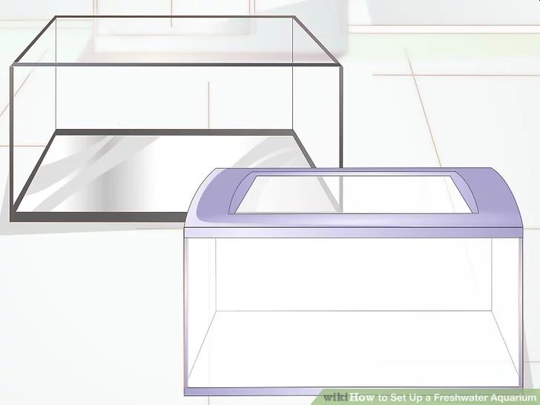
7d Make a Freshwater Aquarium
How to Set Up a Freshwater Aquarium
Choose a fish tank.
The tank you choose needs to be large enough to hold enough water for the type and number of fish you plan to have.
In general, the larger the fish are, the more waste they make and the more water is needed.
Keep in mind that live plants and other decorations will also take up space.
A 55 gallon (208.2 L) tank is a standard size that will allow you to have a variety of fish.
You could also go with a 20 or 25 gallon tank for a starter tank and keep just a few hardy fish.
It is not recommended to start out with anything less than 10 gallons because it is actually harder to maintain good water quality in a small tank.

Slide 36
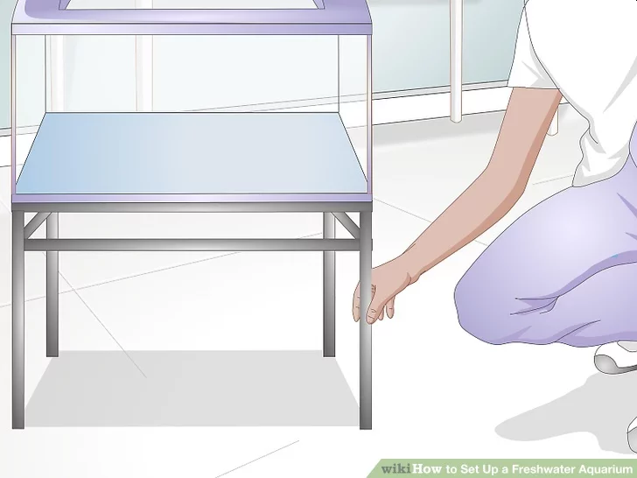
How to Set Up a Freshwater Aquarium
Get an aquarium stand. Aquariums that hold 20 gallons (75.7 L) or more will need a stand no matter what.
Buy one that is designed for the dimensions and shape of your tank.
Make sure the stand is either rated for the size of your tank or that it has been custom built to be very sturdy.
Furniture like dressers, TV stands, end tables/buffets, or flimsy wooden desks aren't strong enough.
Look for complete tank kits at those big box pet stores.
Used setups from websites like Craigslist are often available for great prices, but be sure to check for leaks and clean very well before use.

Slide 37
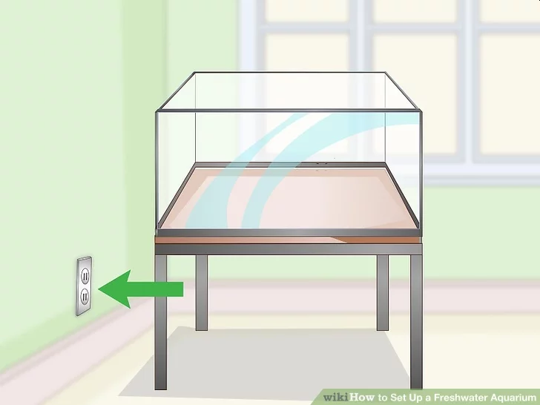
Make a Freshwater Aquarium
Decide where to put the aquarium and stand. Put it in a place where the temperature remains pretty consistent and the amount of light doesn't get overpowering.
Too much sunlight will cause excessive algae growth and a maintenance nightmare.
An interior wall, away from bright light, is best.
Allow at least 5 inches (12.7 cm) between the wall and the aquarium to make room for the filter.
Choose a location near an outlet, and keep in mind how far you will have to haul water for weekly tank maintenance!
Set up your tank stand ideally on a wooden floor, not a rug or carpet.

Slide 38
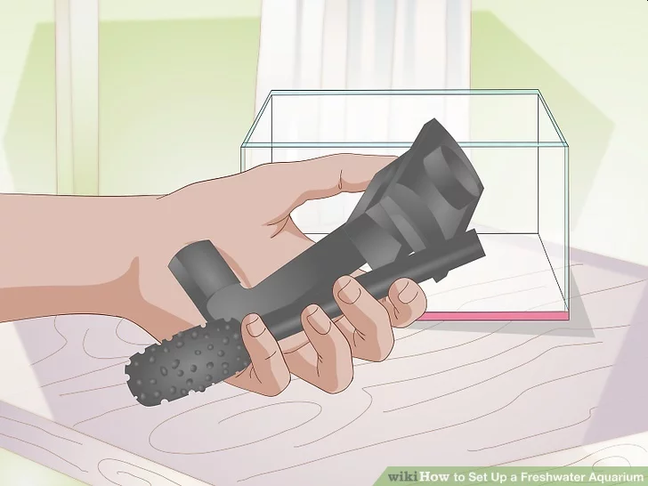
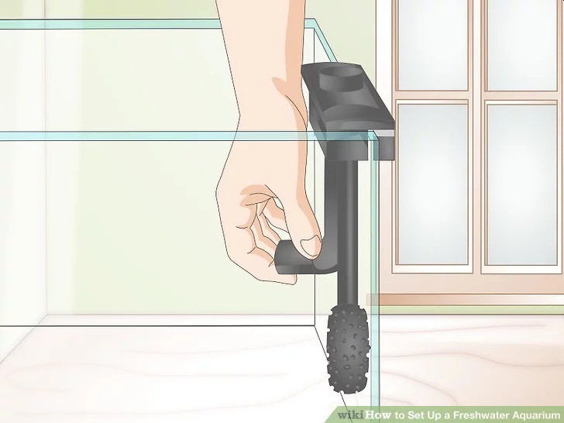
Make a Freshwater Aquarium
Decide which filtration system you would like to use. The most common and easiest are either under-gravel filters or power filters (recommended for first-time owners over under-gravel filters) that hang on the back of the tank.
If you decide to go with a power filter, select one that will circulate enough water for the size of your tank.
Ideally, it should filter your water 5 or more times per hour (gph), depending on your tank capacity.
For example, a 10-gallon tank would need a filter that circulates at least 50 gph.
Install the filter.

Slide 39
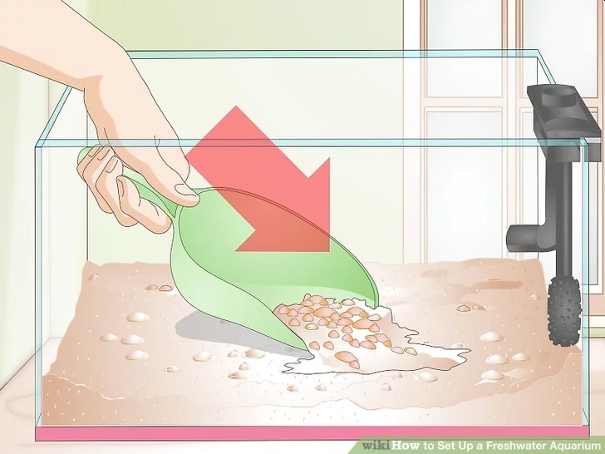
Make a Freshwater Aquarium
Fill the bottom with gravel. Having about 2 to 3 inches (5.1 to 7.6 cm) of gravel on the bottom is essential to a healthy aquarium.
Cheap gravel can be purchased from pet stores dealing in aquarium products.
Sand is optimal for fish and invertebrates that like to burrow but it needs to be stirred on a regular basis to prevent dead spots that can wreak havoc on your tank.
Rinse the substrate in clean water before adding it to the aquarium.
The less dust in the water, the faster it'll clear when the filter is started up.
This step is especially crucial if you're using sand instead of gravel.
Spread the rinsed substrate in an even layer across the surface of the filter.
Put a plate on top of the substrate so it doesn't disperse when you add water.

Slide 40
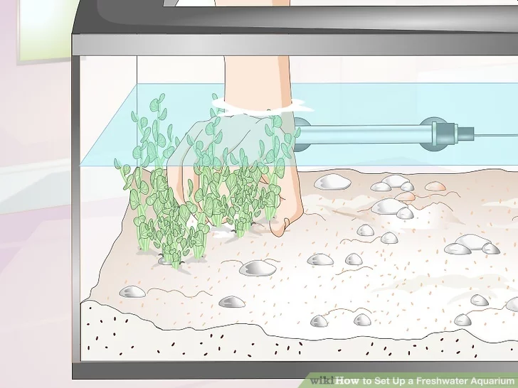
Make a Freshwater Aquarium
Set up chosen plants and decorations. Make sure you arrange them how you like at this point because once the water and fish are in the tank, you'll want to have as little stress as possible––and that means no hands in the tank.
Plants are functional decorations; it is difficult to make a mechanical filter control a plankton bloom, but live plants make it easy.
For some fish, plants actually help them stay healthy.
Submerge the roots in the gravel, but not the stems or leaves.

Slide 41
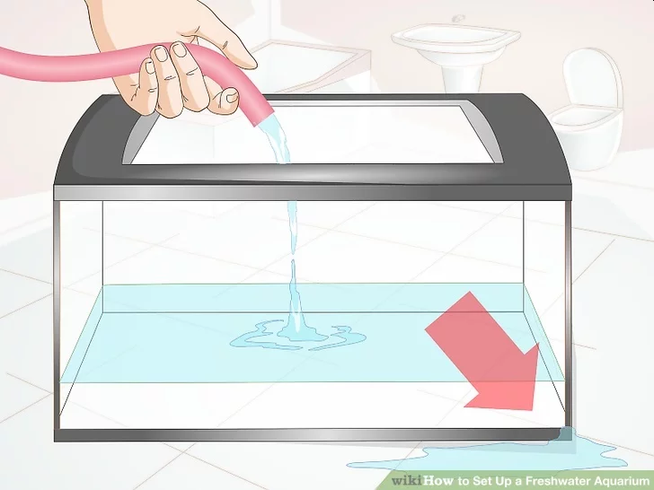
Make a Freshwater Aquarium
Look for leaks. Fill the tank with about two inches of water, then wait for a half an hour.
If there are any leaks, it's better they show up now, rather than when you have filled the entire thing.
If you don't see leaks, fill up the tank about 1/3 full.
Have sealant on hand so that you can dry the tank and start fixing it.

Slide 42
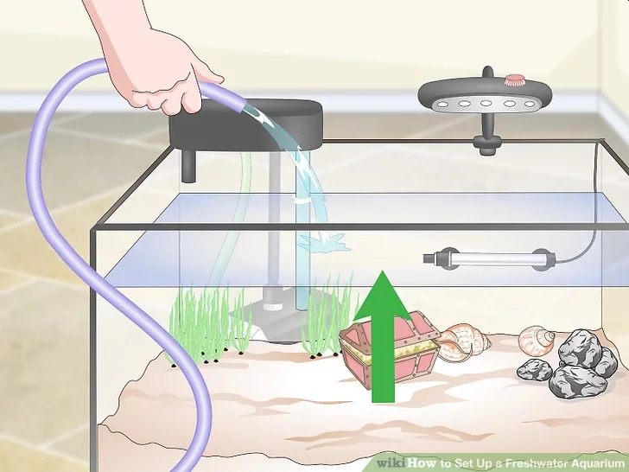
Make a Freshwater Aquarium
Fill the tank the rest of the way. Once you are sure that all the decorations are just the way you want, fill the tank up to just under the rim of the tank, leaving a gap of 1 inch.

Slide 43
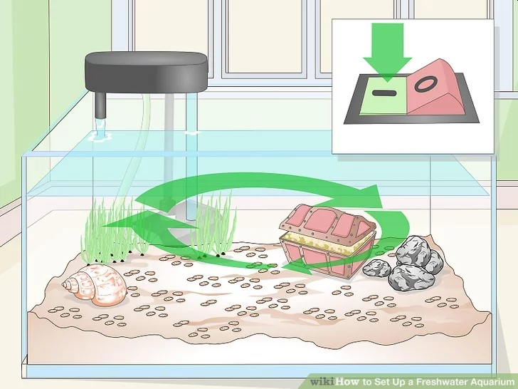
Make a Freshwater Aquarium
Start the filter. Fill the reservoir of the filter with water, and plug it in!
Water should smoothly (and quietly) circulate after a couple of minutes.
Plug in the powerhead/pump if you have an under-gravel filter.
Water should start moving vertically in the lift tube(s).
Wait for an hour or two and check that the temperature is still in the safe range, that there are no leaks, and that the water is circulating properly.

Slide 44
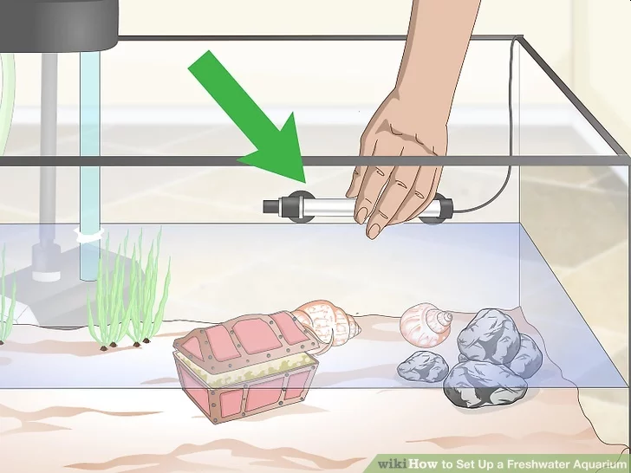
Make a Freshwater Aquarium
Install your heater on the inside of the tank. It will attach with suction cups.
Try to position it near or at the mouth of the filter expelling water so that the water will be evenly heated.
Plug in the heater and install your thermometer.
Do not turn it on until the tank is filled completely with water.
A good rule of thumb is 3-5 watts of heat per gallon of water.
Most fish like it between 70 and 80 degrees Fahrenheit.
Give the heater time to adjust the temperature before cycling the tank.

Slide 45
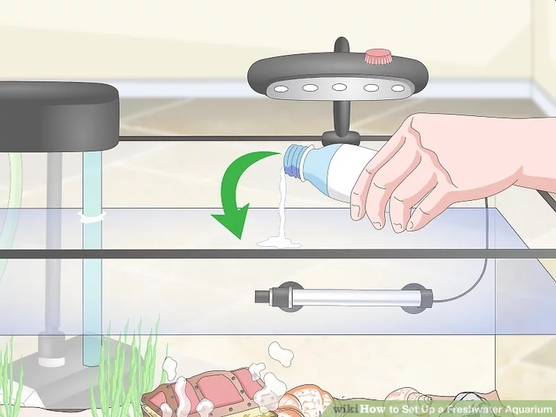
Make a Freshwater Aquarium
Add water dechlorinator. Tap water from a municipal supply contains chlorine and other chemicals that will kill fish, so it's necessary to add a neutralizer.
Add the dechlorinator according to the instructions on the bottle.
The activated carbon of your filter may need to be removed while the chemical circulates, otherwise, the filter may remove it before it has a chance to detoxify the water.

Slide 46
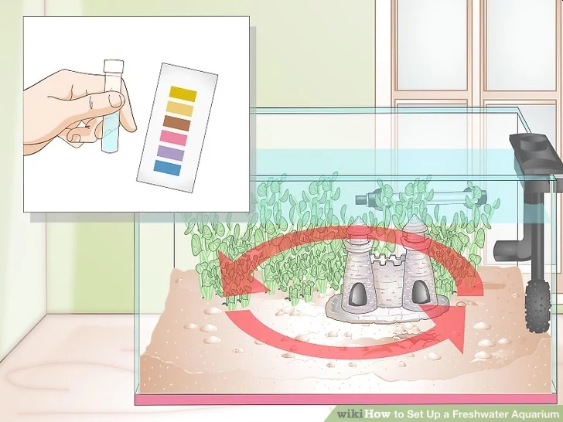
Make a Freshwater Aquarium
Cycle your tank. For instructions on the fishless cycle (the most humane way to grow the beneficial bacteria all tanks need) see Do a Fishless Cycle.
The cycle must be completed before you add any fish to the tank, or they will die.
During the cycle, you need to monitor the water parameters (pH, High pH, Ammonia, Nitrite, and Nitrate).
When the numbers for Ammonia, Nitrite, and then Nitrate spike and lower to 0, you have completed your initial Nitrogen Cycle and are in the clear to add fish.
The only way to reduce the Nitrates is to do water changes. Continue doing water tests, especially with a new tank.
You may need to do daily 15% water changes to keep your fish tank clean, depending on the nitrate levels.
Adding live plants will reduce the number of nitrates as well.

Slide 47
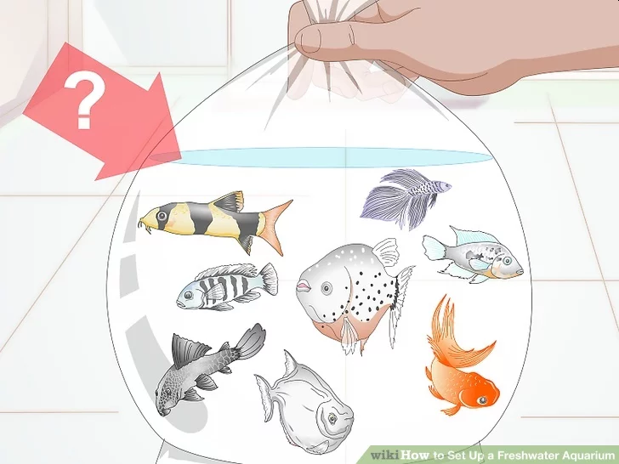
Make a Freshwater Aquarium
Choose fish. Be aware of the size of the adult fish (not the baby you're getting) and do not get a fish you won't be able to handle down the line.
Do lots of research before adding any fish to your tank.

Slide 48
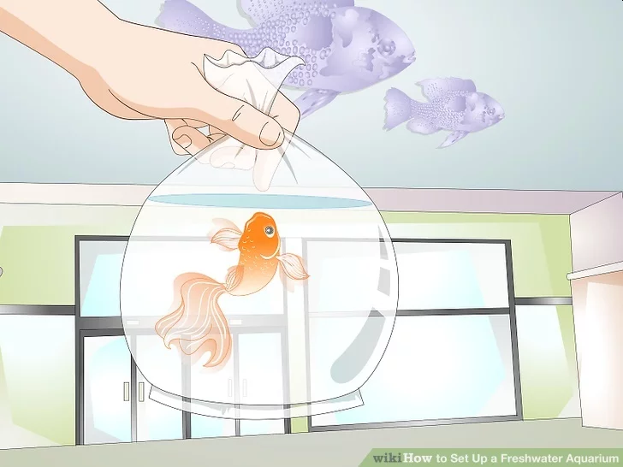
Make a Freshwater Aquarium
Don't add all of your fish at once.
Know all the fish you hope to eventually have in your fish tank and add two of the smallest (this goes for all types except for schooling fish, which should be bought in groups of 4 (ideally 6+).
You can introduce a new group of fish every 2 weeks.
Add the largest fish last.

Slide 49
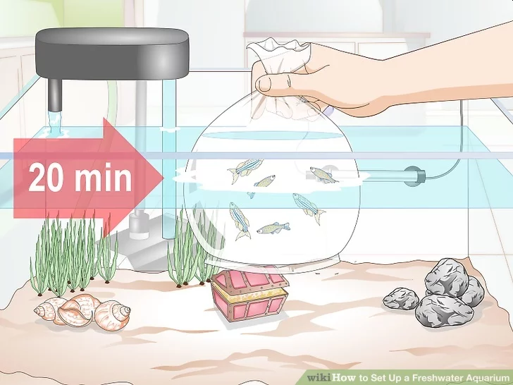
Make a Freshwater Aquarium
Acclimate your fish.
Set the bag in your tank and let it sit there for about 20 or 30 minutes.
Then open the bag and let some of the water from the tank in.
Let it sit for another 20 or 30 minutes before gently releasing the fish into tank.

Slide 50
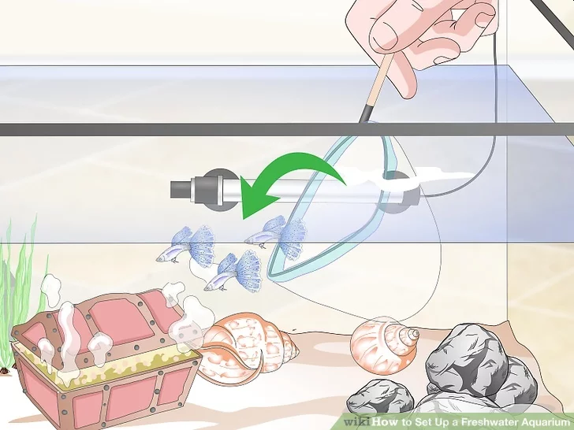
Make a Freshwater Aquarium
Introduce the fish to your aquarium.
Start with two or three fish the first ten days, then get two or three more, wait another ten days, etc.
If you put too many fish at once into a new tank, the water will not be able to adequately cycle, and will quickly turn toxic.
Patience is the key for the first six to eight weeks.
That said, a big mistake people make is to add only 1 or 2 schooling fish.
This is stressful and cruel for the fish.
A school means that a group of 5 is the minimum.

Slide 51
Requirement 8
Using resources found at the library and in periodicals, books, and the internet (with your parent's permission), learn about three different positions held by fisheries and/or wildlife professionals. Find out the education and training requirements for each position.

Slide 52
Careers in Fish and Wildlife Management
Competition for positions is stiff in the field of fish and wildlife management.
This makes getting good grades in school and a solid college education essential.
Begin by pursuing a broad-based education that strengthens your understanding of natural resources as well as the social, economic, and political forces that affect how decisions are made.
Introductory courses in subjects such as wildlife, zoology, math, statistics, computer science, English composition, and botany all are practical.
Starting early with volunteer work also is a great way to gain valuable experience while making friends and contacts in the profession.
Contact your local fish and wildlife service to inquire about volunteer opportunities.

Slide 54
Careers in Fish and Wildlife Management
Wildlife biologist
Zoologist
Fish hatchery superintendent
Oceanographer
Fish and game warden
Watershed manager
Forest or park ranger
Environmental analyst
Soil conservationist
Fisheries officer
Conservation educator
Park naturalist
Fisheries biologist
Marine resources technician
Ornithologist
Parks planning technician
Resource manager
Refuge manager
Forester
Park superintendent
Environmental educator
Zookeeper/curator

